Slide 1
How to save confidential information in terraform
Terraform vault

Slide 2
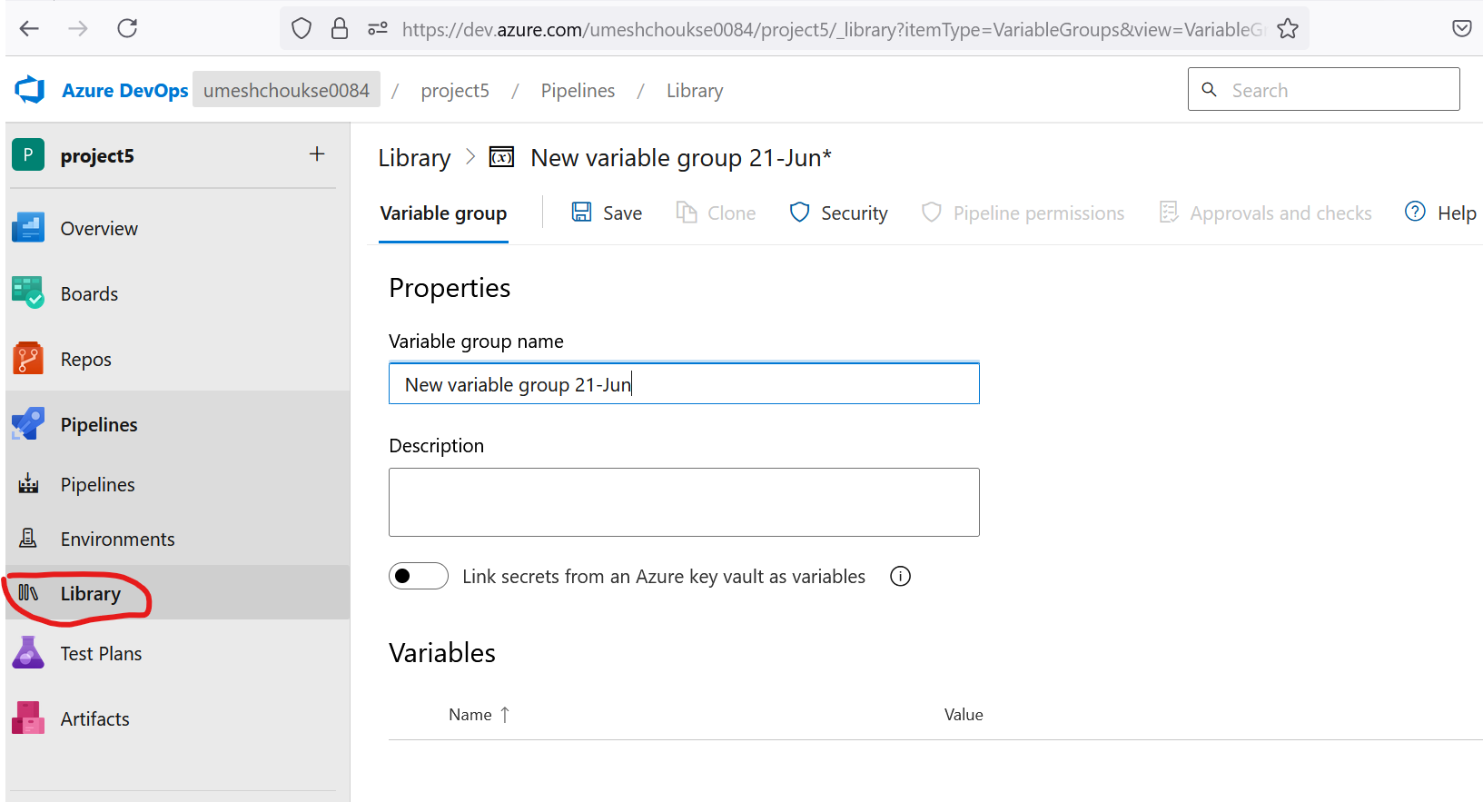
We use pipeline property in Azure Devops pipeline

